Slide 1
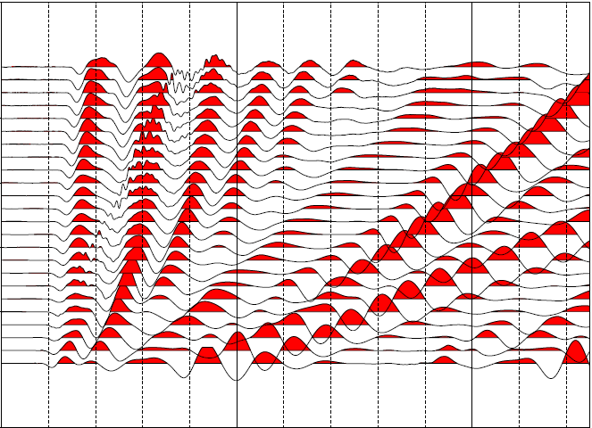
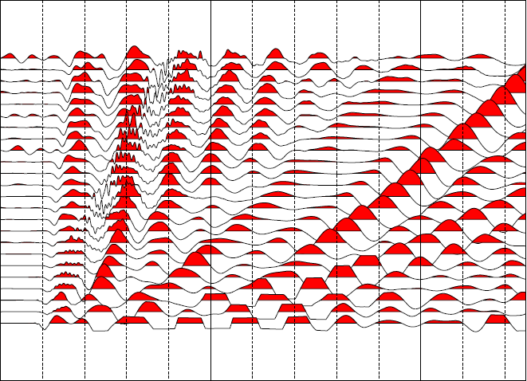
Traditional System
Drone System
0 50 100 150 200 250
Time (ms)

